Slide 1

Train Scheduling System
By:
Leah Ten Eyck
Alan Vuong
Stephanie Strain
Abdulla Ghosheh

Slide 2


Program Run Through
Video Link

Slide 3

Code Purpose:
Allows users to schedule trips from Orange County to either Los Angeles or San Diego
User chooses their desired destination
Code outputs departure schedule for the chosen destination
User chooses a departure time from schedule
Code outputs the departure and arrival times as well as total travel time
User given the choice to view schedule again and/or schedule another trip

Slide 4

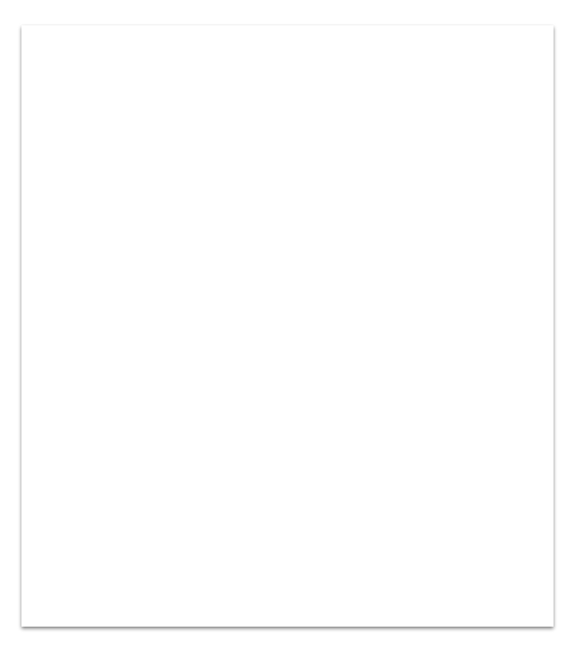
Library Headers
#include <iostream> Provides C++ input and output functionality using streams (cplusplus.com)
#include <vector> Provides the container class template and will allow ordered list of values to be stored and used (stanford.edu)
#include <string> Provides the functionality for the string variable which stores a sequence of letters or other characters (zybooks.com)

Slide 5

Essential Variables and Functions:
Int OuterUserInput:
User chooses destination
Void departuresToLA():
Outputs departure schedule to Los Angeles
Void departuresToSD():
Outputs Departure schedule to San Diego
Int InnerUserInput:
User chooses departure time from schedule
Char viewMenuInput:
User chooses if they would like to see the departure schedule again
Char quitProgram: If user does not want to schedule another trip then program quits

Slide 6


Int outerUserInput
User Chooses Destination from Menu Options
1 for Los Angeles and 2 for San Diego
This start screen is shown whenever the program restarts.
After first trip is scheduled, if user wishes to schedule another trip this start screen is shown again.

Slide 7
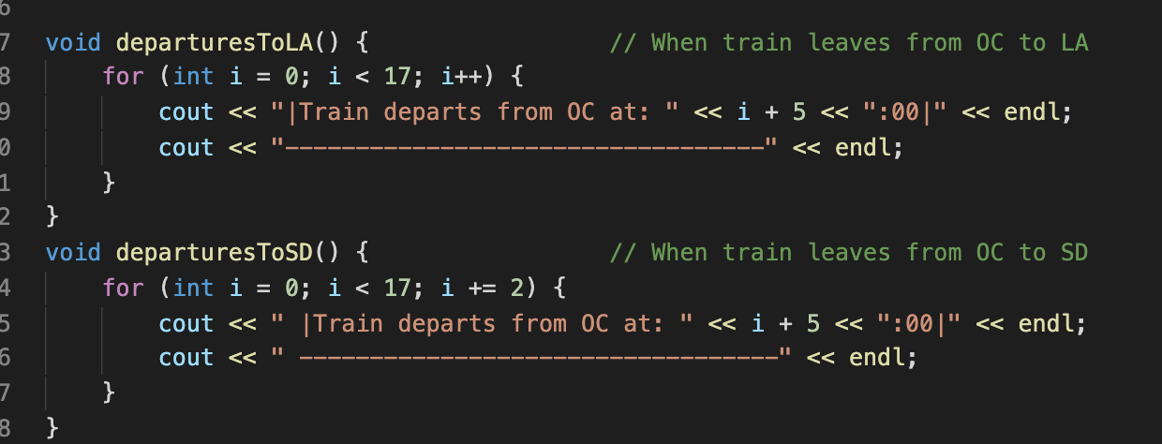
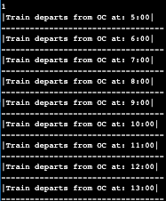
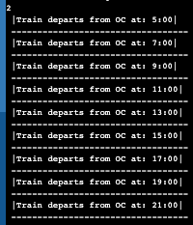
Void departuresToLA() & Void DeparturesToSD()
Outputs departure times to Los Angeles and San Diego
Train To LA departs every hours
Loop executes starting at 5 and adding one each time
Train to SD departs every two hours
Loop executes by adding two each time
Departures to LA
Departures to SD
Notes:
Wanted to start at 5 because stands for 5 o’clock

Slide 8
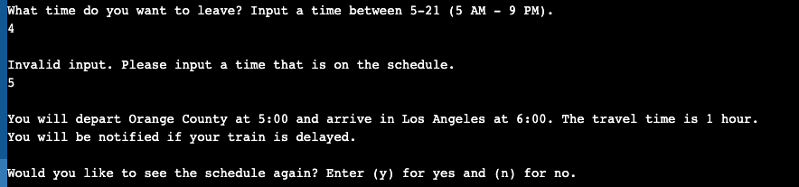
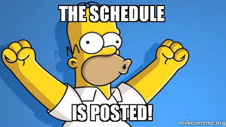
Int innerUserInput
User is prompted to choose a time from the schedule
Inputs a time between 5-21 (between 5am - 9pm in 24- hour time)
Error message is shown if invalid time is inputed
When valid time is inputed, message with departure time, arrival time, and total travel time is shown..
Notes:
innerUserInput stores the user time that they want to leave.

Slide 9
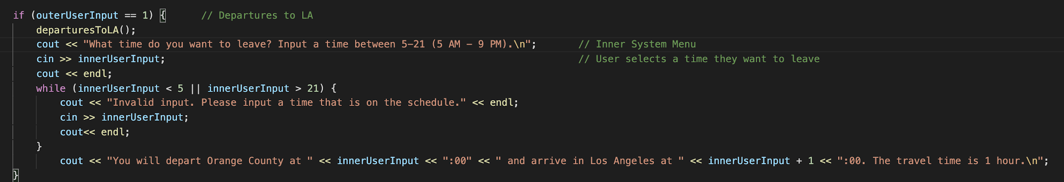
Los Angeles Travel Schedule Output
innerUserInput:
User inputs time between 5-21 ( which is 5am-9pm in 24-hour time)
While Loop:
Checks if user’s input is valid, if it is not, then error message is shown. Loop continues until input is between 5 and 21
Travel Schedule Output:
Program uses innerUserInput and innerUserInput + 1 to show departure time and arrival time.
Notes:
innerUserInput stores the time that user wants to leave

Slide 10
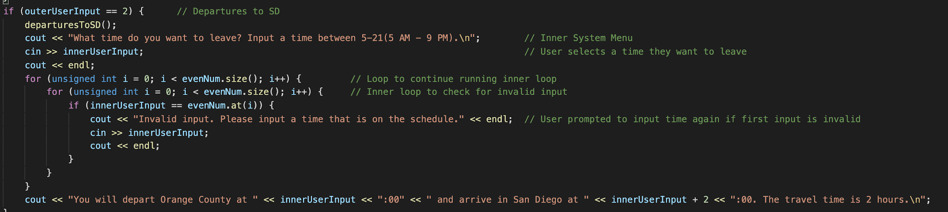
San Diego Travel Schedule Output
innerUserInput:
User inputs time between 5-21 ( which is 5am-9pm in 24 hour time)
For Loop:
Used a vector to define evenNum to allow program to easily check if user input is valid (even numbers are not valid)
Travel Schedule Output:
Program uses innerUserInput and innerUserInput + 2 to show departure time and arrival time.
Notes:
Uses nested For Loops, inner loop to check for invalid input, outer loop to continue running the inner loop.
Travel Schedule Output: innnerUserInput + 2 because travel time is 2 hours.

Slide 11

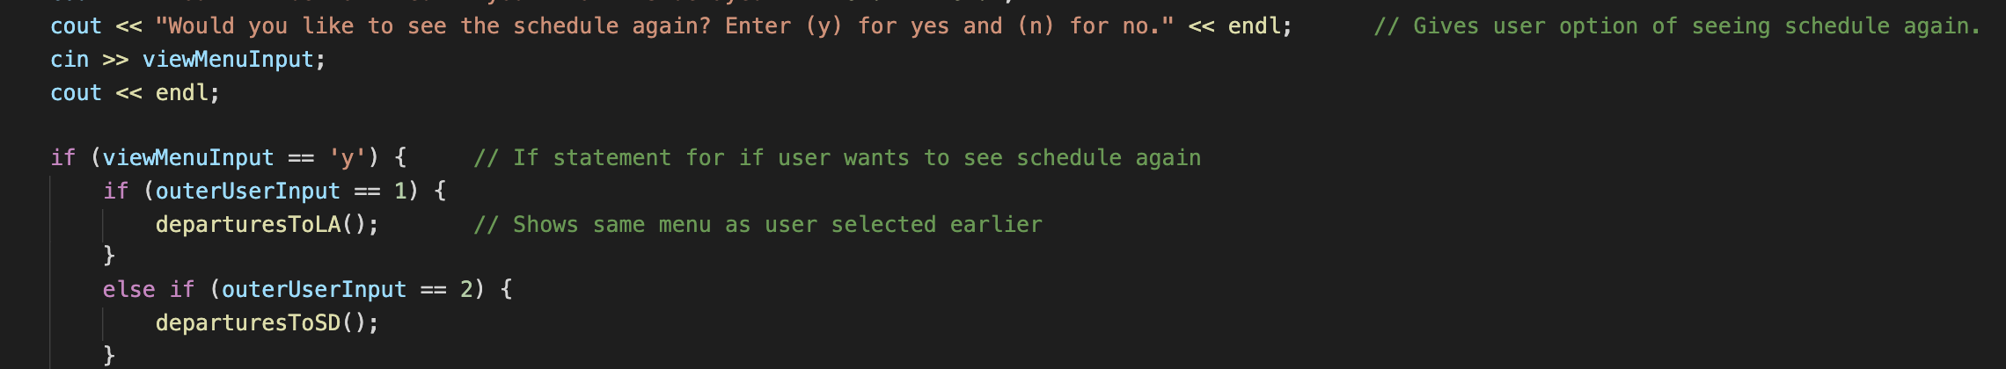
Char viewMenuInput
After viewing travel itinerary, user is asked if they would like to see the schedule for their chosen location again
If yes, the program uses outerUserInput from original location choice to determine which schedule to output.

Slide 12


Char quitProgram
User is asked if they would like to schedule another trip
If yes, program loops back to start screen
If no, program outputs “Thank you ! Please come again soon!”

Slide 13
Bibliography
Class Vector<valuetype>, The Stanford C++ Libraries, www.web.stanford.edu/class/archive/c
s/cs106b/cs106b.1126/materials/cppdoc/Vector-class.html. Accessed 12 April 2020
Input/Output Library, Cplusplus, 2000-2020, www.cplusplus.com/reference/iolibrary/. Accessed
15 April 2020
Iterating Through Vectors, Zybooks, ISBN: 978-1-394-02093-5. www.learn.zybooks.com/zybo
ok/SADDLEBACKCS1ASolerSpring2020/chapter/5/section/4. Accessed 8 April 2020
For Loops, Zybooks, ISBN: 978-1-394-02093-5. www.learn.zybooks.com/zybook/SADDLEB
ACKCS1ASolerSpring2020/chapter/4/section/4. Accessed 8 April 2020
While Loops, Zybooks, ISBN: 978-1-394-02093-5. www.learn.zybooks.com/zybook/SADDLEB
ACKCS1ASolerSpring2020/chapter/4/section/2. Accessed 1 April 2020

